Slide 1
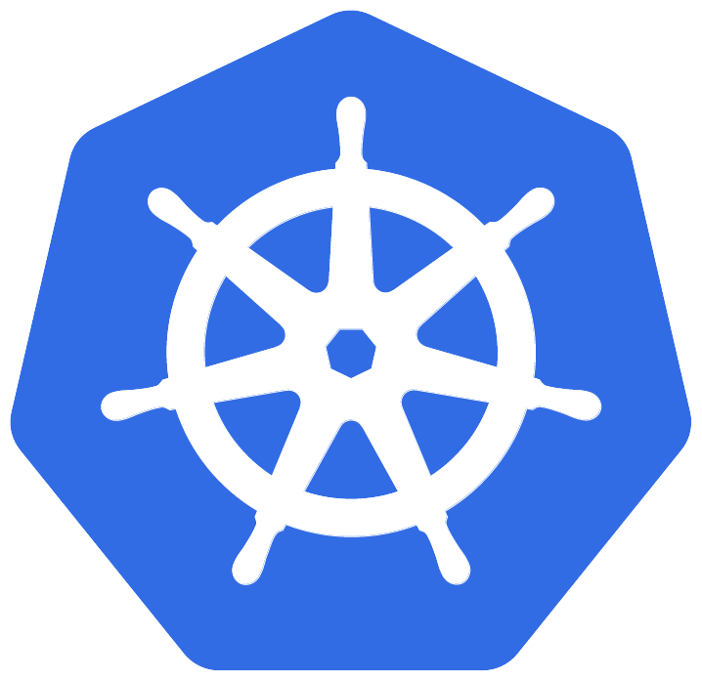
Contain Your Enthusiasm
A Full Day with Containers and Kubernetes
Philly.NET Code Camp 2019.2

Slide 2
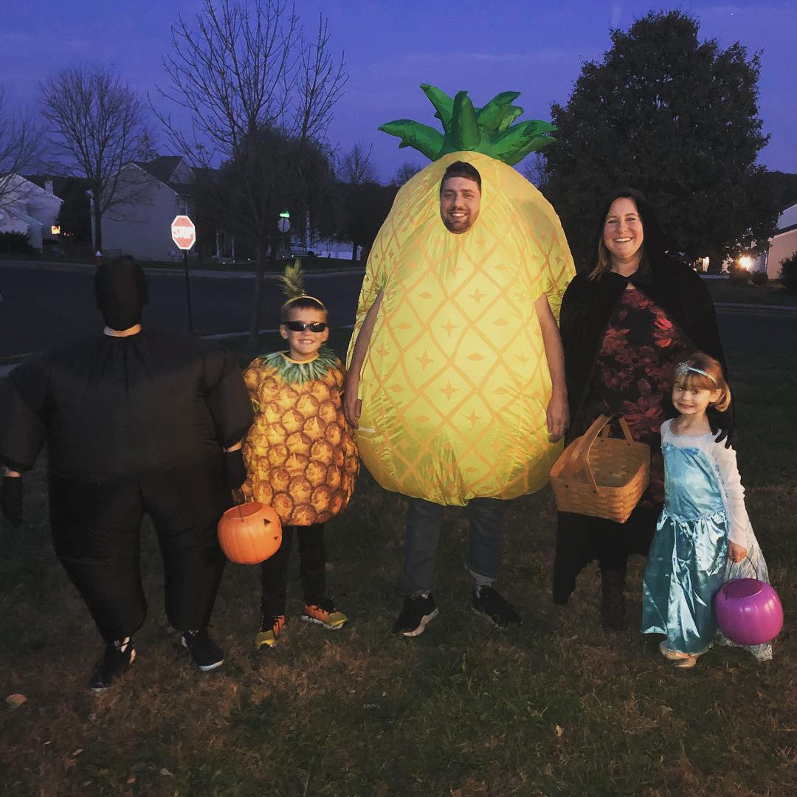

Jason van Brackel
Sr. Solutions Archtect
Rancher Labs
morehuman.software

Slide 3
Agenda
A Brief History of Containers
Virtualization and Container Concepts
Docker
Docker Container Fundamentals
Docker Architecture
Docker Image Authoring
Introduction to Kubernetes
Kubernetes Concepts
Kubernetes Quickstart with Rancher

Slide 4

A Brief History of Containers

Slide 5
A Brief History of Containers
Changing the root directory of a process and all of its children to a new location in the filesystem
The beginning of process isolation
1979: Unix V7
chroot
Source: A Brief History of Containers: From 1970s chroot to Docker 2016
http://blog.aquasec.com/a-brief-history-of-containers-from-1970s-chroot-to-docker-2016

Slide 6
A Brief History of Containers
FreeBSD Jails allows administrators to partition a FreeBSD computer system into independent, smaller systems
Called “jails”
An IP address can be assigned for each system and configuration
2000: FreeBSD
jails
Source: A Brief History of Containers: From 1970s chroot to Docker 2016
http://blog.aquasec.com/a-brief-history-of-containers-from-1970s-chroot-to-docker-2016

Slide 7
A Brief History of Containers
Linux VServer is a jail mechanism that can partition resources
  file systems, network addresses, memory
Introduced in 2001, this operating system virtualization that is implemented by patching the Linux kernel
Experimental patches are still available, but the last stable patch was released in 2006
2001: Linux VServer
Source: A Brief History of Containers: From 1970s chroot to Docker 2016
http://blog.aquasec.com/a-brief-history-of-containers-from-1970s-chroot-to-docker-2016

Slide 8
A Brief History of Containers
Oracle released a Solaris Container that combines system resource controls and boundary separation provided by zones, which were able to leverage features like snapshots and cloning from ZFS (Zettabyte File System)
In 2005, the bulk of Solaris, including ZFS, was licensed as open-source software under the Common Development and Distribution License (CDDL), as the OpenSolaris project
Became a standard feature in Solaris 10
2004: Solaris Containers
Source: A Brief History of Containers: From 1970s chroot to Docker 2016
http://blog.aquasec.com/a-brief-history-of-containers-from-1970s-chroot-to-docker-2016

Slide 9
A Brief History of Containers
This is an operating system-level virtualization technology for Linux
  Used a patched Linux kernel for virtualization, isolation, resource management and check-pointing
The code was not released as part of the official Linux kernel
2005: Open Virtuzzo (OpenVZ)
Source: A Brief History of Containers: From 1970s chroot to Docker 2016
http://blog.aquasec.com/a-brief-history-of-containers-from-1970s-chroot-to-docker-2016

Slide 10
A Brief History of Containers
Google project designed to limit, account for, and isolate resource usage
Later renamed to cgroups. Merged into the Linux kernel at 2.6.24 (24 Jan 2008)
2006: Process Containers
Source: A Brief History of Containers: From 1970s chroot to Docker 2016
http://blog.aquasec.com/a-brief-history-of-containers-from-1970s-chroot-to-docker-2016

Slide 11
A Brief History of Containers
LXC (Linux Containers) was the first, most complete implementation of Linux container manager
Implemented in using cgroups and Linux namespaces
Linux kernel without requiring any patches
2008: LXC
Source: A Brief History of Containers: From 1970s chroot to Docker 2016
http://blog.aquasec.com/a-brief-history-of-containers-from-1970s-chroot-to-docker-2016

Slide 12
A Brief History of Containers
Built by CloudFoundry
Their own version of LxC
Isolates environments on any operating system, running as a daemon and providing an API for container management
Developed a client-server model to manage a collection of containers across multiple hosts
Includes a service to manage cgroups, namespaces and process life cycle
2011: Warden
Source: A Brief History of Containers: From 1970s chroot to Docker 2016
http://blog.aquasec.com/a-brief-history-of-containers-from-1970s-chroot-to-docker-2016

Slide 13
A Brief History of Containers
Let Me Contain That For You (LMCTFY) Open-Source version of Google's container stack, providing Linux application containers
Applications can be made “container aware,” creating and managing their own sub-containers
Active deployment in LMCTFY stopped in 2015 after Google started contributing core LMCTFY concepts to libcontainer
Which is now part of the Open Container Foundation
2013: LMCTFY
Source: A Brief History of Containers: From 1970s chroot to Docker 2016
http://blog.aquasec.com/a-brief-history-of-containers-from-1970s-chroot-to-docker-2016

Slide 14
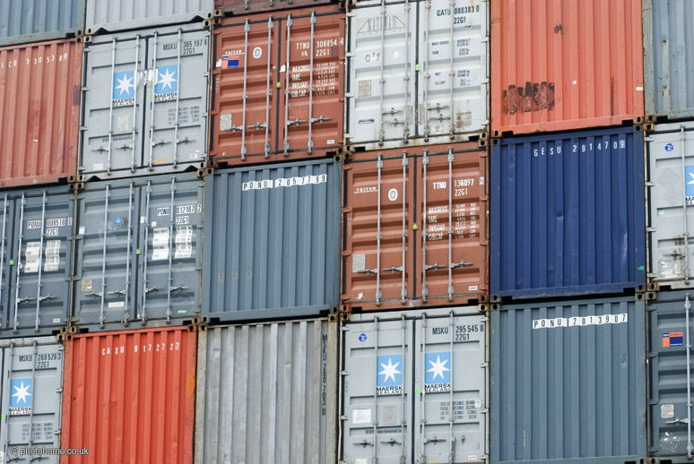
Virtualization and Container Concepts

Slide 15
Virtualization
Virtual Memory
Application Virtualization (JIT / JVM)
Hardware Virtualization (VMWare / Hyper-V)
Containers (OS Virtualization)

Slide 16
Containers – OS Virtualization
Local Disk looks like a pristine copy of the OS
Memory appears consistent with a freshly booted OS

Slide 17
Containers are not Virutal Machines
VMs
Containers
App A
App A₁
App B
App A
App A₁
App A₂
App A₃
App B
App B₁
Docker
Guest OS
Guest OS
Guest OS
Host OS
Hypervisor (Type 2)
Server
Host OS
Server

Slide 18
Containers are not Virutal Machines
VMs
Containers
App A
App A₁
App B
App A
App A₁
App A₂
App A₃
App B
App B₁
Docker
Guest OS
Guest OS
Guest OS
Host OS
Hypervisor (Type 1)
Server
Server

Slide 19
Containers are not Virutal Machines
VMs
Containers
App A
App A₁
App B
App A
App A₁
App A₂
App A₃
App B
App B₁
Docker
App A
App A₁
App A₂
App A₃
App B
App B₁
Docker
App A
App A₁
App A₂
App A₃
App B
App B₁
Docker
Guest OS
Guest OS
Guest OS
Host OS
Host OS
Host OS
Hypervisor (Type 1)
Hypervisor (Type 1)
Server
Server

Slide 20
Containers are not Virutal Machines
VMs
Hardware Virtualization
OS Isolation
Full Copy of the OS
Hypervisor responsible for maintaining isolation
Containers
OS Virtualization
Userspace and Namespace Isolation
Enough of the OS for the Application to use
Docker Daemon responsible for maintaining isolation

Slide 21
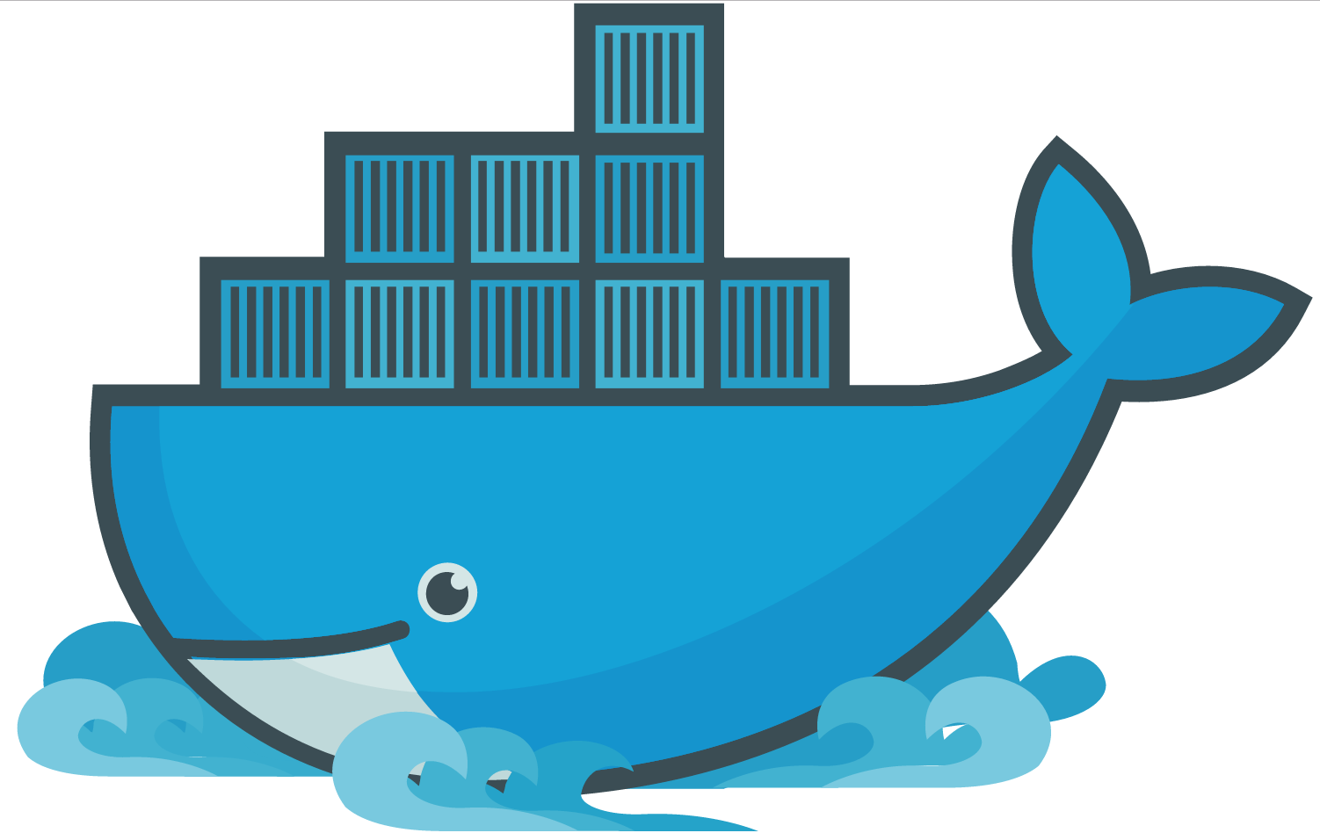
Docker

Slide 22
Docker
A company
A suite of tools for building, deploying and managing applications using Docker containers
An container engine

Slide 23
Docker
It runs docker images
  docker
  dockerd
Docker Engine

Slide 24
Docker
A virtualized development environment to create docker images in Windows and Mac OSX
  Backed by VirtualBox
  Conflicts with Hyper-V
  Conflicts with Docker for Windows
Docker Toolbox

Slide 25
Docker
Tool for defining and running multi-container Docker applications
  Define your app’s environment with a Dockerfile
  Define services that make up your app in docker-compose.yml
  Run
Docker Compose

Slide 26
Docker
Competing Orchestrator to Kubernetes and Mesosphere
Probably not worth your time
Docker Swarm

Slide 27

Docker Container Fundamentals

Slide 28
Docker Container Fundamentals
dockerd
Thin layer between containers and the kernel
Docker Daemon

Slide 29
Docker Container Fundamentals
Developers use dockerfiles to buildld container images
Dockerfile

Slide 30
Dockerfile
FROM microsoft/iis
RUN mkdir C:\site
RUN powershell -NoProfile -Command \
Import-module IISAdministration; \
New-IISSite -Name "Site" -PhysicalPath C:\site -BindingInformation "*:8000:“
ADD content/ /site

Slide 31
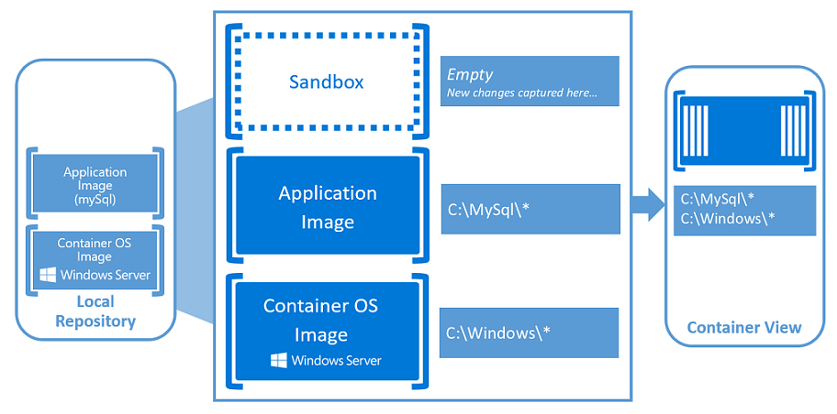
Container Fundamentals
Source: Windows Containers - https://docs.microsoft.com/en-us/virtualization/windowscontainers/about/index

Slide 32
Docker Container Fundamentals
Container Images are Published and Stored here
Docker Hub is a public cloud-based container registry managed by Docker
Container Registry

Slide 33
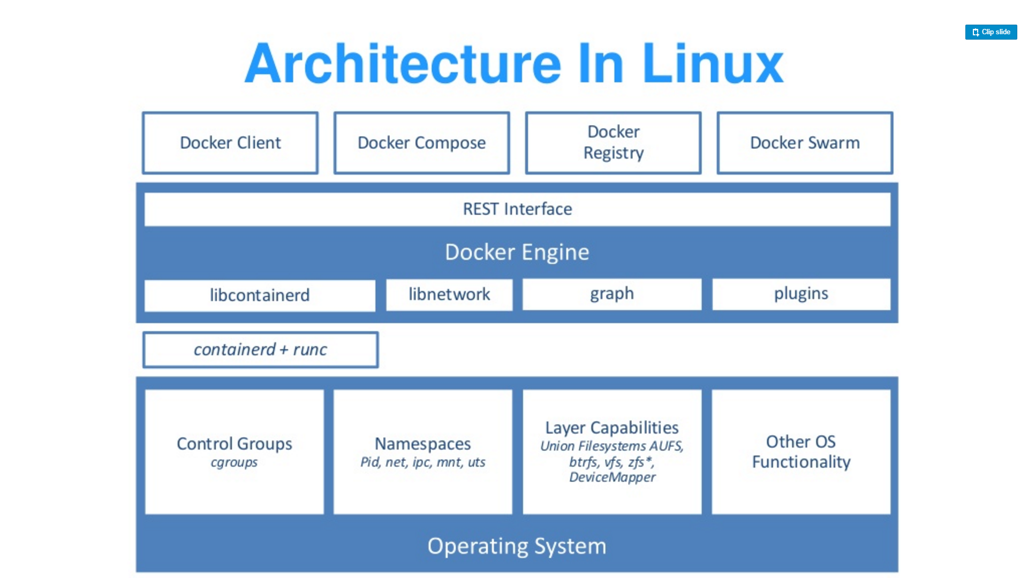
Docker Architecture

Slide 34
Source: “DockerCon 16: Windows Server & Docker - The Internals Behind Bringing Docker & Containers to Windows - Black Belt”

Slide 35
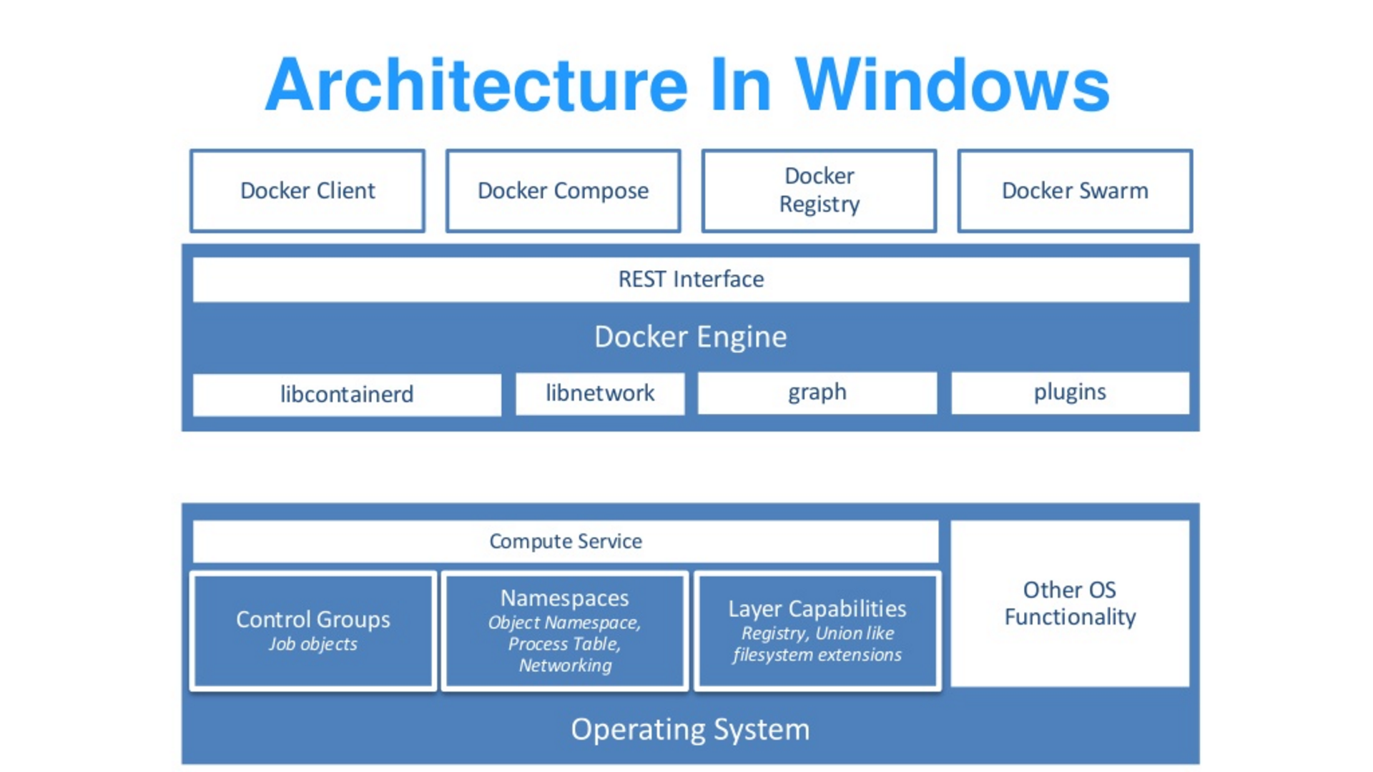
Source: “DockerCon 16: Windows Server & Docker - The Internals Behind Bringing Docker & Containers to Windows - Black Belt”

Slide 36
Docker Architecture
Docker library written in Go
Cross-Platform
Users underlying OS fundamentals to create containers
https://github.com/moby/moby/tree/master/libcontainerd
libcontainerd
Source: “DockerCon 16: Windows Server & Docker - The Internals Behind Bringing Docker & Containers to Windows - Black Belt”

Slide 37
Docker Architecture
Simple daemon that uses runc to manage containers
Containerd uses gRPC to expose a CRUD interface around containers
Docker Engine expands this, but also images, volumes, networks, builds, etc. using a full-blown HTTP API
runc & containerd
Source: “DockerCon 16: Windows Server & Docker - The Internals Behind Bringing Docker & Containers to Windows - Black Belt”

Slide 38
Docker Architecture
Public interface to manage running containers
Replaces containerd for Windows
Abstracts low-level kernel capabilities
https://blogs.technet.microsoft.com/virtualization/2017/01/27/introducing-the-host-compute-service-hcs/
Compute Service
Source: “DockerCon 16: Windows Server & Docker - The Internals Behind Bringing Docker & Containers to Windows - Black Belt”

Slide 39
Docker Architecture
Part of the Win32 API
Allows a group of processes to be managed as a single object
https://msdn.microsoft.com/en-us/library/windows/desktop/ms684161(v=vs.85).aspx
Job Objects
Source: “DockerCon 16: Windows Server & Docker - The Internals Behind Bringing Docker & Containers to Windows - Black Belt”

Slide 40
Docker Architecture
Extends the Job Object
New Namespace Virtualization
  Registry
  Process ID
  Object Namespace
  File system
  Network Compartments
Namespaces (Silos)
Source: “DockerCon 16: Windows Server & Docker - The Internals Behind Bringing Docker & Containers to Windows - Black Belt”

Slide 41
Docker Architecture
Kernel view of the world prior to Windows Server 1709
  \DosDevices\C:\Windows
  \Registry
  \Device\Tcp
  \Device\Null
Similar concept to chroot Windows Server 1709+
  \Silo\foo\DosDevices\C:\Windows
  \Silo\bar\DosDevices\C:\Windows
Namespaces (Silos)
Source: “DockerCon 16: Windows Server & Docker - The Internals Behind Bringing Docker & Containers to Windows - Black Belt”

Slide 42
Docker Architecture
Windows Applications expect NTFS semantics
Building an union FS with NTFS semantics is hard
Hybrid Model
  NTFS partitions per container
  Symlinks to layers on the host file system
File system
Source: “DockerCon 16: Windows Server & Docker - The Internals Behind Bringing Docker & Containers to Windows - Black Belt”

Slide 43
Docker Architecture
Docker uses Unionfs to layer Docker images.
As actions are done to a base image, layers are created and documented, such that each layer fully describes how to recreate an action.
This strategy enables Docker's lightweight images, as only layer updates need to be propagated.
UnionFS
Source: “DockerCon 16: Windows Server & Docker - The Internals Behind Bringing Docker & Containers to Windows - Black Belt”

Slide 44
Docker Architecture
Linux Containers
  Docker Containers
  Rocket Containers
  Kata Containers
  OCI Containers
Windows Containers
  Windows Server Containers
  Hyper-V Containers
Containers
Source: “DockerCon 16: Windows Server & Docker - The Internals Behind Bringing Docker & Containers to Windows - Black Belt”

Slide 45
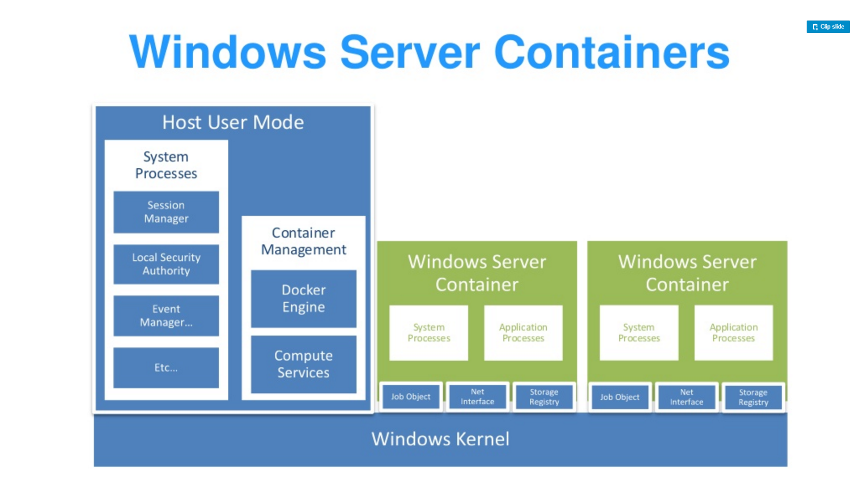
Source: “DockerCon 16: Windows Server & Docker - The Internals Behind Bringing Docker & Containers to Windows - Black Belt”

Slide 46
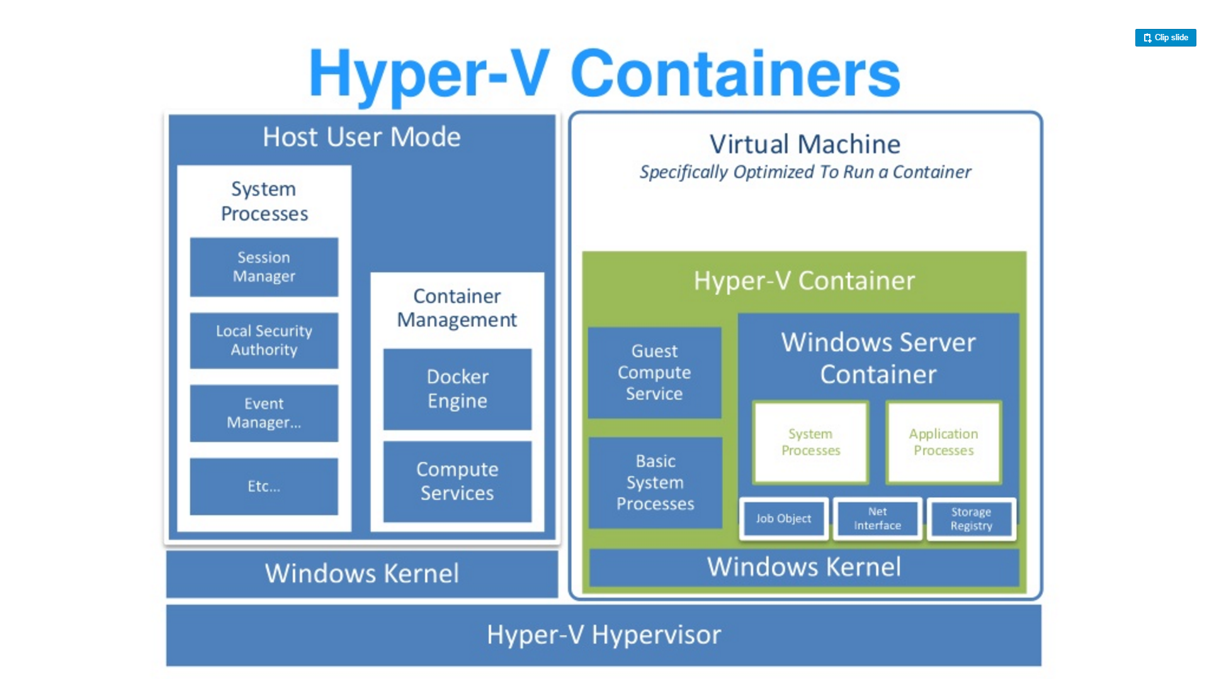
Source: “DockerCon 16: Windows Server & Docker - The Internals Behind Bringing Docker & Containers to Windows - Black Belt”

Slide 47
Docker Architecture
Default in Windows 10
Small, stateless VM
  Writes are not persisted
Storage attached via SMB
  Over VMBus not networking
Physically map executables from the host file cache
Networking is a virtual nic
Cloning
  Launch utility VM
  Freeze State
  Fork the VM for each new instance
    No startup time
    Shares memory
Hyper-V Containers
Source: “DockerCon 16: Windows Server & Docker - The Internals Behind Bringing Docker & Containers to Windows - Black Belt”

Slide 48
For more infomration
DockerCon 16: Windows Server & Docker - The Internals Behind Bringing Docker & Containers to Windows - Black Belt
https://channel9.msdn.com/Blogs/containers/DockerCon-16-Windows-Server-Docker-The-Internals-Behind-Bringing-Docker-Containers-to-Windows

Slide 49
Deeper into Dockerfile

Slide 50
Dockerfile
FROM microsoft/iis
RUN mkdir C:\site
RUN powershell -NoProfile -Command \
Import-module IISAdministration; \
New-IISSite -Name "Site" -PhysicalPath C:\site -BindingInformation "*:8000:“
ADD content/ /site

Slide 51
Deeper into Dockerfile
Containers should be ephemeral
Consistent with Processes section of 12 factor application methodology
General Guidelines

Slide 52
Deeper into Dockerfile
Avoid installing unnecessary packages
  Reduces complexity
  Reduces dependencies
  Reduces files sizes
  Reduces build times
General Guidelines

Slide 53
Deeper into Dockerfile
Each container should do 1 thing
  Containers that depend on one another should be networked
  Not one process per container
General Guidelines

Slide 54
Deeper into Dockerfile
Sort multi-line arguments
  Easier to read and maintain
RUN apt-get update && apt-get install -y \
bzr \
cvs \
git \
mercurial \
subversion
General Guidelines

Slide 55
Deeper into Dockerfile
FROM
Sets the base image
FROM <image>
FROM <image>:<tag>
Commands

Slide 56
Deeper into Dockerfile
RUN
Executes the command on the current image and commits the results
RUN <command>
/bin/sh –c
cmd /S /C
RUN [“executable”, “param1”, “param2”]
Commands

Slide 57
Deeper into Dockerfile
CMD
There can be only one per Dockerfile
The main purpose is to provide defaults for an executing container.
CMD ["executable","param1","param2"]
Commands

Slide 58
Deeper into Dockerfile
EXPOSE
Informs the Docker engine that the container listens to this port at run time
EXPOSE <port> [<port>...]
Commands

Slide 59
Deeper into Dockerfile
ENV
Sets an environment variable in the container
ENV key value
ENV key=value
Commands

Slide 60
Deeper into Dockerfile
ADD
Copies files from the developer’s system to the container’s file system
ADD <src>... <dest>
ADD ["<src>",... "<dest>"] (this form is required for paths containing whitespace)
Commands

Slide 61
Deeper into Dockerfile
COPY
Copies files from the developer’s system to the container’s file system.
COPY <src>... <dest>
COPY ["<src>",... "<dest>"] (this form is required for paths containing whitespace)
Commands

Slide 62
Deeper into Dockerfile
ENTRYPOINT
An ENTRYPOINT allows you to configure a container that will run as an executable
FROM ubuntu
ENTRYPOINT ["top", "-b"]
FROM debian:stable
RUN apt-get update && apt-get install -y --force-yes apache2
EXPOSE 80 443
VOLUME ["/var/www", "/var/log/apache2", "/etc/apache2"]
ENTRYPOINT ["/usr/sbin/apache2ctl", "-D", "FOREGROUND"]
Commands

Slide 63
Deeper into Dockerfile
VOLUME
The VOLUME instruction creates a mount point with the specified name and marks it as holding externally mounted volumes from native host or other containers.
FROM ubuntu
RUN mkdir /myvol
RUN echo "hello world" > /myvol/greeting
VOLUME /myvol
docker run -v /Users/<path>:/<container path>
docker run -v //c/<path>:/<container path>
Commands

Slide 64
Deeper into Dockerfile
USER
The USER instruction sets the user name or UID to use when running the image and for any RUN, CMD and ENTRYPOINT instructions that follow it in the Dockerfile
Commands

Slide 65
Deeper into Dockerfile
WORKDIR
The WORKDIR instruction sets the working directory for any RUN, CMD, ENTRYPOINT, COPY and ADD instructions that follow it in the Dockerfile. If the WORKDIR doesn’t exist, it will be created even if it’s not used in any subsequent Dockerfile instruction.
WORKDIR /a
WORKDIR b
WORKDIR c
RUN pwd
Commands

Slide 66
Deeper into Dockerfile
ARG
The ARG instruction defines a variable that users can pass at build-time to the builder with the docker build command using the --build-arg <varname>=<value>
ARG <name>[=<default value>]
Commands

Slide 67
Deeper into Dockerfile
ONBUILD
The ONBUILD instruction adds to the image a trigger instruction to be executed at a later time, when the image is used as the base for another build. The trigger will be executed in the context of the downstream build, as if it had been inserted immediately after the FROM instruction in the downstream Dockerfile.
ONBUILD [INSTRUCTION]
Commands

Slide 68
Deeper into Dockerfile
HEALTHCHECK
The HEALTHCHECK instruction tells Docker how to test a container to check that it is still working.
HEALTHCHECK --interval=5m --timeout=3s \
CMD curl -f http://localhost/ || exit 1
Commands

Slide 69
Deeper into Dockerfile
SHELL
The SHELL instruction allows the default shell used for the shell form of commands to be overridden. The default shell on Linux is ["/bin/sh", "-c"], and on Windows is ["cmd", "/S", "/C"].
SHELL ["powershell", "-command"]
RUN Write-Host hello
Commands

Slide 70
Dockerfile Examples

Slide 71
nginx
https://github.com/dockerfile/nginx

Slide 72
Chrome over VNC
https://github.com/dockerfile/chrome

Slide 73
Java
https://github.com/dockerfile/java

Slide 74
IIS
https://github.com/Microsoft/iis-docker

Slide 75
SQL Server
https://github.com/Microsoft/mssql-docker

Slide 76
WCF
https://github.com/Microsoft/wcf-docker-samples

Slide 77
Multi-Stage Build
https://github.com/Microsoft/containerized-microservices-pipeline-service

Slide 78
Bonus: Docker Compose Example
https://docs.docker.com/compose/aspnet-mssql-compose/

Slide 79
A Short History of Kubernetes

Slide 80
A Short History of Kubernetes
Monolithic < Distributed
SOA < Micro Services
VMs < Containers
Closed < Open
Static < Dynamic
Centralization < Decentralization
Key Trends

Slide 81
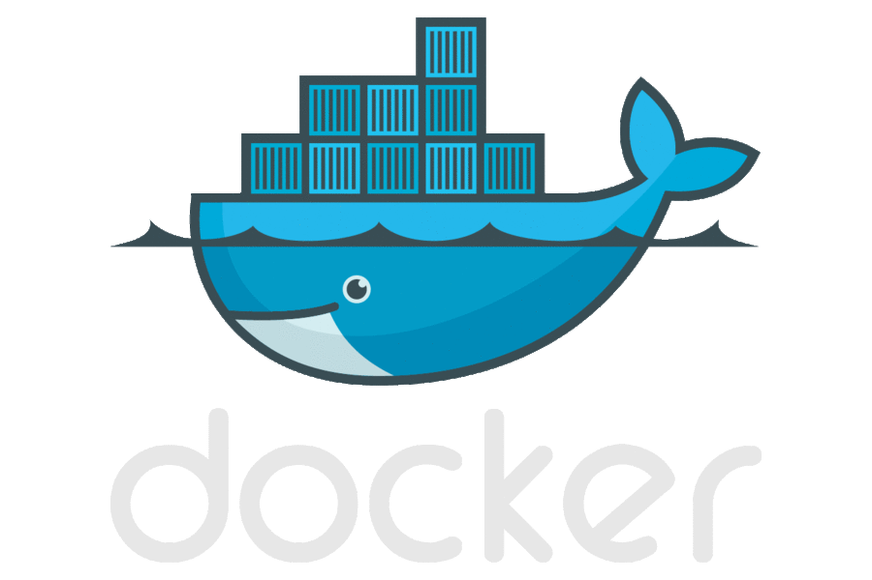
A Short History of Kubernetes
Performance
Repeatability
Isolation
Density
Quality of service
Accounting
Visibility
Portability
Why Containers

Slide 82
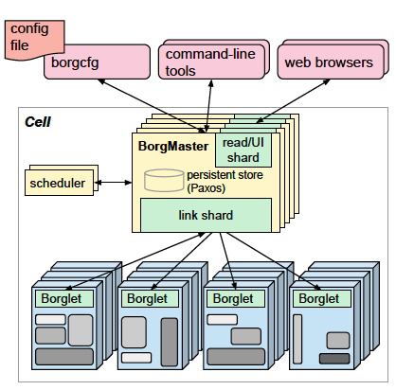
A Short History of Kubernetes
Runs hundreds of thousands of jobs..
..for many thousands of different applications (YouTube, Search Index, Maps, etc.)..
..across a number of clusters (hundreds)..
..each with up to tens of thousands of machines..
Borg currently manages many millions of physical servers hosting billions of containers!
In production since 2003!
Offers a declarative job specification language, name service integration, real-time job monitoring, and tools to analyze and simulate system behavior.
Source: Large-scale cluster management at Google with Borg
https://ai.google/research/pubs/pub43438
Google Borg

Slide 83

A Short History of Kubernetes
“Google is living years in the future, sending the rest of us messages!”
Doug Cutting
Co-creator of Lucene, Nutch & Hadoop

Slide 84
A Short History of Kubernetes
“Jobs” are restrictive as the only grouping mechanism for tasks.
No first-class way to manage an entire multi-job service as a single entity, or to refer to related instances of a service (e.g., canary and production tracks).
Complex name parsing mechanisms as hacks.
Inflexible semantics as a consequence.
Source: Borg, Omega, and Kubernetes – Lessons Learned From Three Container Management Systems Over a Decade
https://ai.google/research/pubs/pub44843
Lessons Learned
The Bad

Slide 85
A Short History of Kubernetes
Resulting Kubernetes Construct
  Labels
Source: Borg, Omega, and Kubernetes – Lessons Learned From Three Container Management Systems Over a Decade
https://ai.google/research/pubs/pub44843
Lessons Learned
The Bad

Slide 86
A Short History of Kubernetes
One IP address per machine complicates things!
Borg tasks all use the single IP address of their host, and share host’s port space…
Issues:
  Borg must schedule ports as a resource;
  Tasks must pre-declare how many ports they need, and be willing to be told which ones to use when they start;
  The Borglet must enforce port isolation; and the naming;
  RPC systems must handle ports as well as IP addresses…
Source: Borg, Omega, and Kubernetes – Lessons Learned From Three Container Management Systems Over a Decade
https://ai.google/research/pubs/pub44843
Lessons Learned
The Bad

Slide 87
A Short History of Kubernetes
Resulting Kubernetes Construct
  Unique Routable IP per Pod, No NAT, No Port Management
Source: Borg, Omega, and Kubernetes – Lessons Learned From Three Container Management Systems Over a Decade
https://ai.google/research/pubs/pub44843
Lessons Learned
The Bad

Slide 88
A Short History of Kubernetes
Allocs are useful!
A Borg alloc (short for allocation) is a reserved set of resources on a machine in which one or more tasks can be run.
Enables helper services / co-scheduled tasks (containers).
Source: Borg, Omega, and Kubernetes – Lessons Learned From Three Container Management Systems Over a Decade
https://ai.google/research/pubs/pub44843
Lessons Learned
The Good

Slide 89
A Short History of Kubernetes
Resulting Kubernetes Construct
  The Pod
Source: Borg, Omega, and Kubernetes – Lessons Learned From Three Container Management Systems Over a Decade
https://ai.google/research/pubs/pub44843
Lessons Learned
The Good

Slide 90
A Short History of Kubernetes
Cluster management is more than task management...
Applications that run on Borg benefit from many other cluster services, including naming and load balancing.
Source: Borg, Omega, and Kubernetes – Lessons Learned From Three Container Management Systems Over a Decade
https://ai.google/research/pubs/pub44843
Lessons Learned
The Good

Slide 91
A Short History of Kubernetes
Resulting Kubernetes Construct
  Services, Cross-cluster VIPs that route to Pods based on Label Selectors
Source: Borg, Omega, and Kubernetes – Lessons Learned From Three Container Management Systems Over a Decade
https://ai.google/research/pubs/pub44843
Lessons Learned
The Good

Slide 92
A Short History of Kubernetes
Introspection is vital.
Borg surfaces debugging information to all users rather than hiding it: Borg has thousands of users, so “self-help” has to be the first step in debugging.
Several levels of UI and debugging tools are available so users can quickly identify anomalous events related to their jobs, and then drill down to detailed event and error logs from their applications and the infrastructure itself.
Source: Borg, Omega, and Kubernetes – Lessons Learned From Three Container Management Systems Over a Decade
https://ai.google/research/pubs/pub44843
Lessons Learned
The Good

Slide 93
A Short History of Kubernetes
Resulting Kubernetes Construct
  Heapster, Metrics Server, cAdvisor, Fluentd, Elasticsearch
Source: Borg, Omega, and Kubernetes – Lessons Learned From Three Container Management Systems Over a Decade
https://ai.google/research/pubs/pub44843
Lessons Learned
The Good

Slide 94
Introduction to Kubernetes

Slide 95
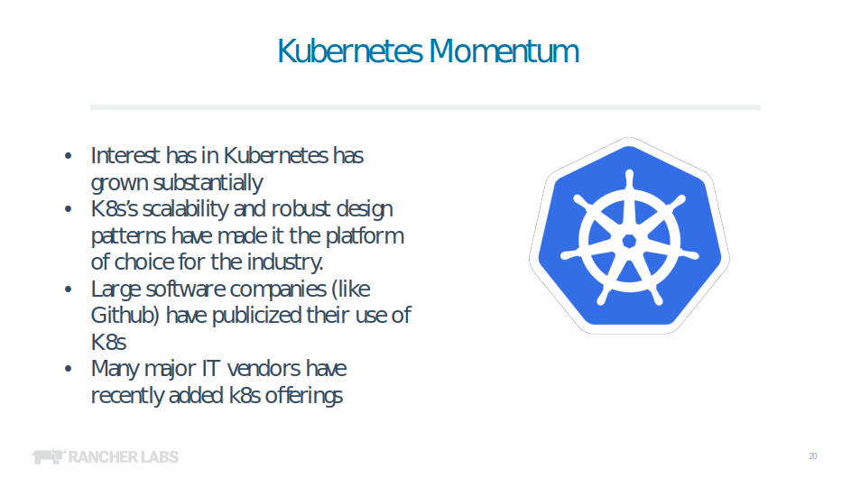

Slide 96
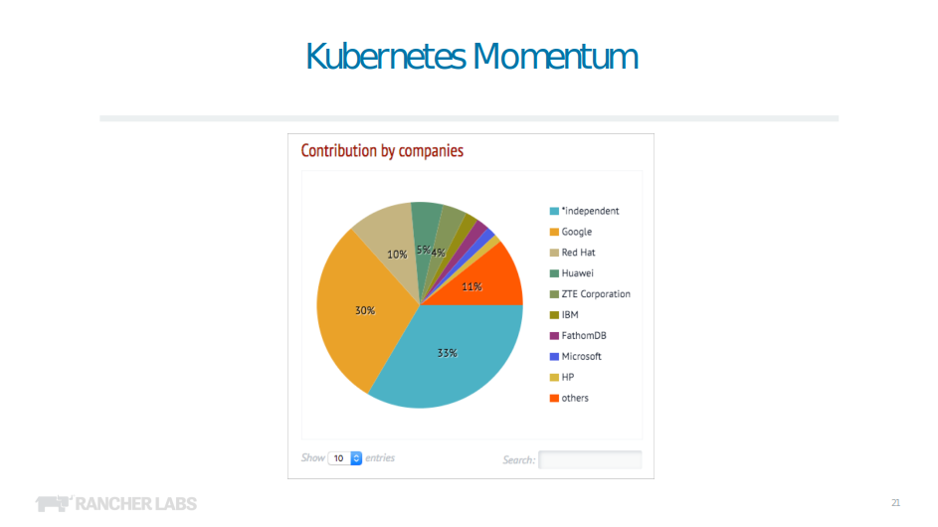

Slide 97
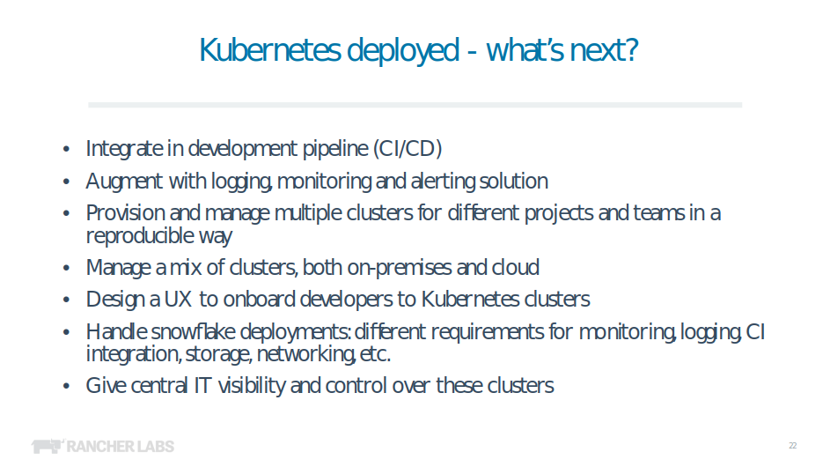
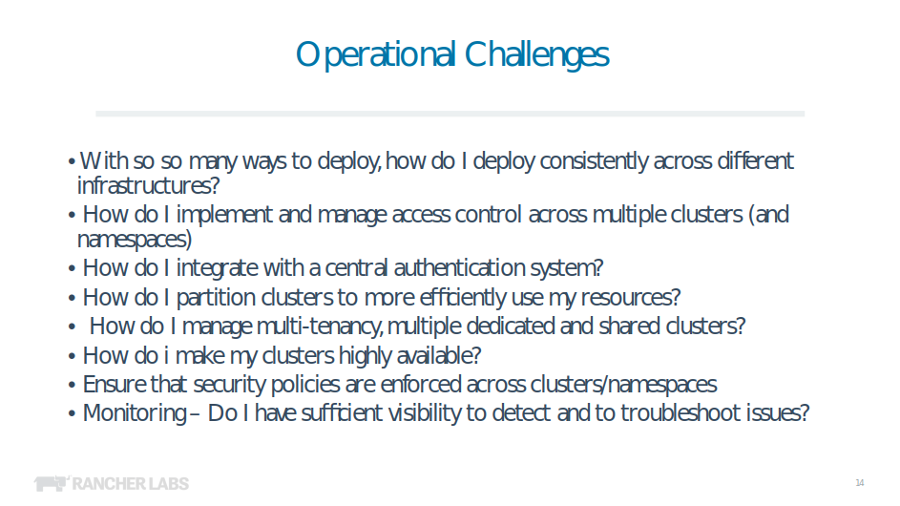

Slide 98
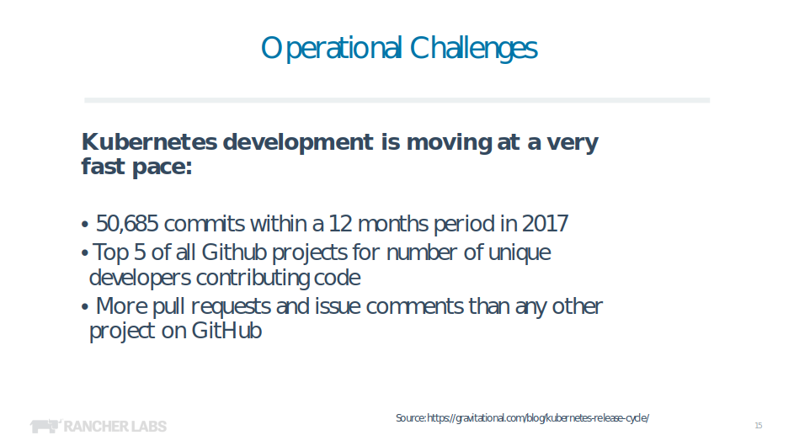

Slide 99
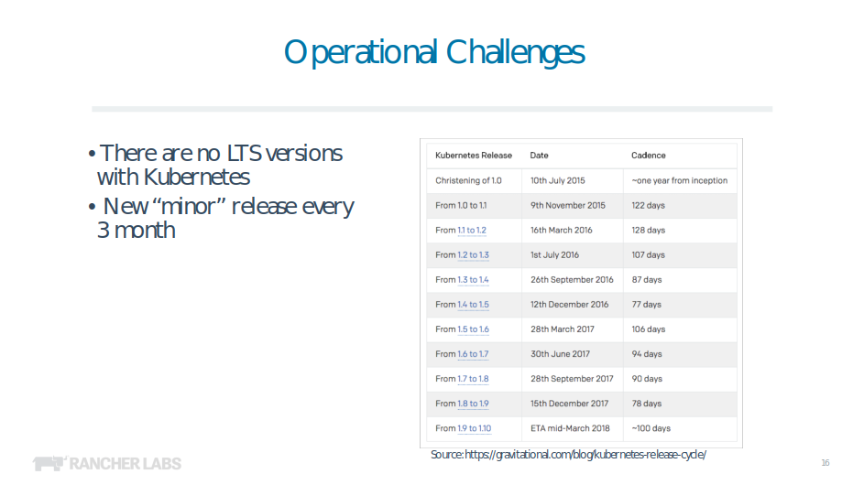

Slide 100
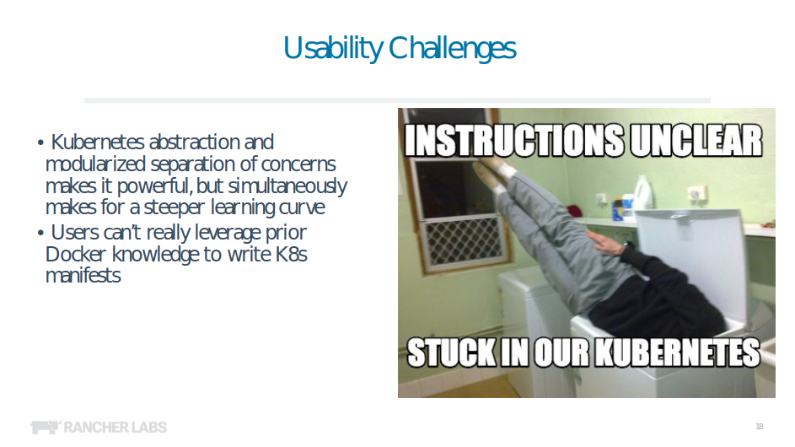

Slide 101
Now what?
Isolation: Keep jobs from interfering with each other
Scheduling: Where should my job be run?
Lifecycle: Keep my job running
Discovery: Where is my job now?
Constituency: Who is part of my job?
Scale-up: Making my jobs bigger or smaller
Auth{n,z}: Who can do things to my job?
Monitoring: What’s happening with my job?
Health: How is my job feeling?

Slide 102
Introduction to Kubernetes
Greek for “Helmsman”; also the root of the word “Governor”
Google’s 3rd Container Platform (Borg, Omega)
Set of compossable building blocks
Container orchestrator
Runs OCI Compliant Containers
Supports multiple cloud and bare-metal environments
Built on lessons learned from Borg and Omega
Written in Go

Slide 103
Introduction to Kubernetes
Completely Open Source
Maintained by the CNCF
Seperated into Special Interest Groups (SIGs)
https://github.com/kubernetes/kubernetes

Slide 104
Introduction to Kubernetes
Completely Open Source
Maintained by the CNCF
Seperated into Special Interest Groups (SIGs)
https://github.com/kubernetes/kubernetes

Slide 105
Intoduction to Kubernetes
Container
Pod
Controller
  Replica Set
  Deployment
Service
Labels
Selector
Config Maps
Ingress
Concepts

Slide 106
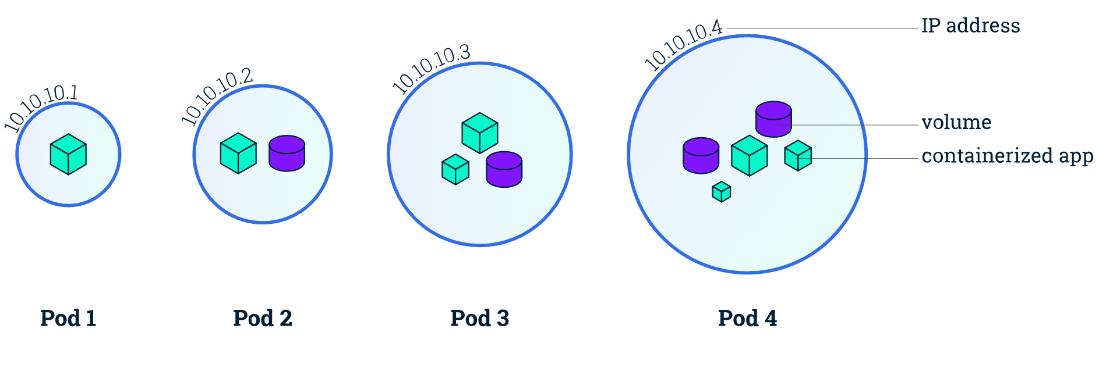
Introduction to Kubernetes
Smallest unit that can be deployed in Kubernetes
Consist of one or more containers that are always scheduled together
Each pod is given a unique IP address
Containers in a pod can speak to each other via localhost
Pod

Slide 107
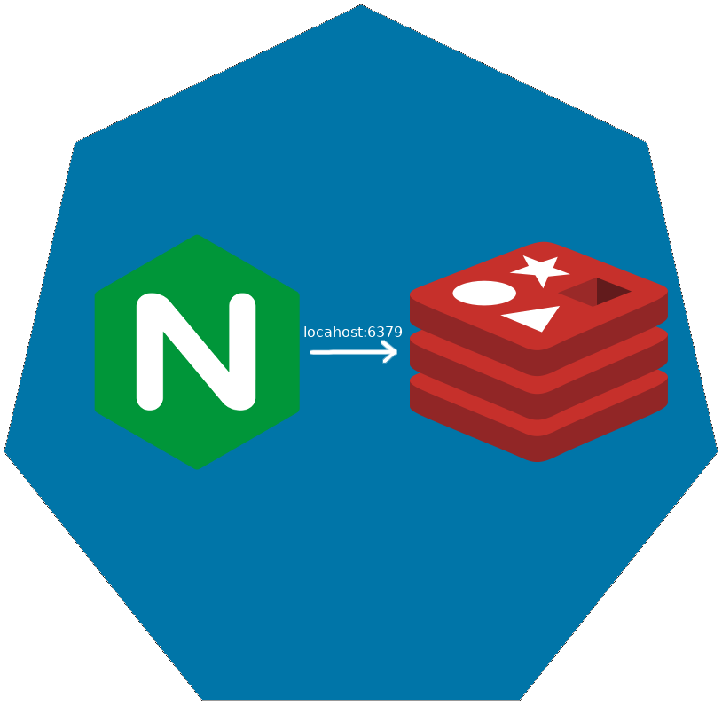
Introduction to Kubernetes
Pod

Slide 108
Intoduction to Kubernetes
Defines the desired scale and state of a group of pods
Driving the current state to the desired state (in controller manager)
Replica Set

Slide 109

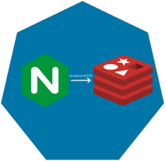
Introduction to Kubernetes
Replica Set

Slide 110

Intoduction to Kubernetes
Replica Set

Slide 111
Introduction to Kubernetes
Replica Set

Slide 112
Introduction to Kubernetes
Level of abstraction above ReplicaSets
Deployments create and update ReplicaSets
Allow you to easily scale and perform rolling upgrades
Deployment

Slide 113
Introduction to Kubernetes
Deployment

Slide 114
Introduction to Kubernetes
Deployment

Slide 115
Introduction to Kubernetes
Deployment

Slide 116
Introduction to Kubernetes
Deployment

Slide 117
Introduction to Kubernetes
Deployment

Slide 118
Introduction to Kubernetes
Deployment

Slide 119
Introduction to Kubernetes
Define a DNS entry that can be used to refer to a group of pods
Provide a consistent endpoint for the group of pods
Different types: nodePort, clusterIP, loadbalancer
Service

Slide 120

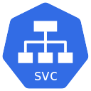
Services (Node Port)
192.168.0.[1-3]:32000

Slide 121
Services (Load Balancer)
Public IP:80

Slide 122
Introduction to Kubernetes
Allow storing of arbitrary configuration values and files
Exposed in pods as either environment variables or as local storage
Decoupled storage of configuration from pod spec
Config Maps

Slide 123
Config Maps
apiVersion: v1
kind: ConfigMap
metadata:
name: dev-config
namespace: default
data:
Item1: dev-stuff
Item2: more dev stuff
apiVersion: v1
kind: ConfigMap
metadata:
name: qa-config
namespace: default
data:
Item1: qa-stuff
Item2: more qa stuff
apiVersion: v1
kind: ConfigMap
metadata:
name: prod-config
namespace: default
data:
Item1: prod-stuff
Item2: more prod stuff

Slide 124
Introduction to Kubernetes
Define how traffic outside the cluster is routed to inside the cluster
Used to expose Kubernetes services to the world
Route traffic to internal services based on factors such as host and path
Ingress is usually implemented by a load balancer (Nginx, HAProxy, AWS ELB, etc…)
Ingresses

Slide 125

Ingresses
https://my-app.cluster.com
https://cluster.com/my-app

Slide 126
Introduction to Kubernetes
Kubernetes Bootcamp
  https://kubernetesbootcamp.github.io/kubernetes-bootcamp/
Kubernetes 101 (User Guide)
  http://kubernetes.io/docs/user-guide/walkthrough/
Kubernetes Labs
  https://www.katacoda.com/courses/kubernetes
Kubernetes up and Running
  http://shop.oreilly.com/product/0636920043874.do
Kubernetes The Hard Way
  https://github.com/kelseyhightower/kubernetes-the-hard-way
Next Steps

